Slide 1
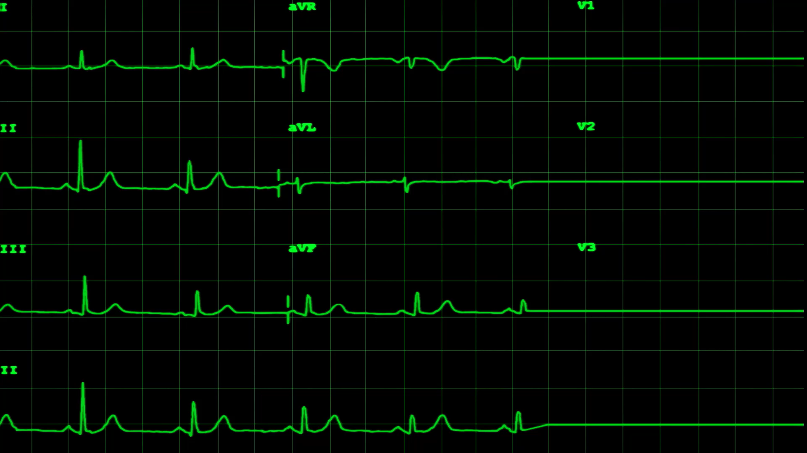
A Parallel Algorithm Template for Updating Single-Source Shortest Paths in Large-Scale Dynamic Networks
Anas Bin Rashid 22i-0907
Amna Tahir 22i-9885
Hasnain Akhtar 22i-1241

Slide 2

Overview
Novel framework for updating SSSP in dynamic networks
Platform-independent parallel approach
Identifies and updates only affected portions of the network
Implemented for both shared-memory and GPU platforms
Significant speedup over recomputing from scratch

Slide 3
Problem Addressed
Real-world networks are large-scale and dynamic
Most SSSP algorithms operate on static graphs
Recomputing SSSP after every change is inefficient
Gap between dynamic network modeling and static algorithms
Need for scalable parallel algorithms for dynamic updates

Slide 4
Background
Single Source Shortest Path (SSSP): Classic graph problem
Applications: Transportation, communication, social networks
Dynamic networks: Structure changes over time
Edge/vertex additions, deletions, weight changes
Sequential update algorithms exist but don't scale well
Parallel implementations are platform-specific
Need for platform-independent frameworks

Slide 5
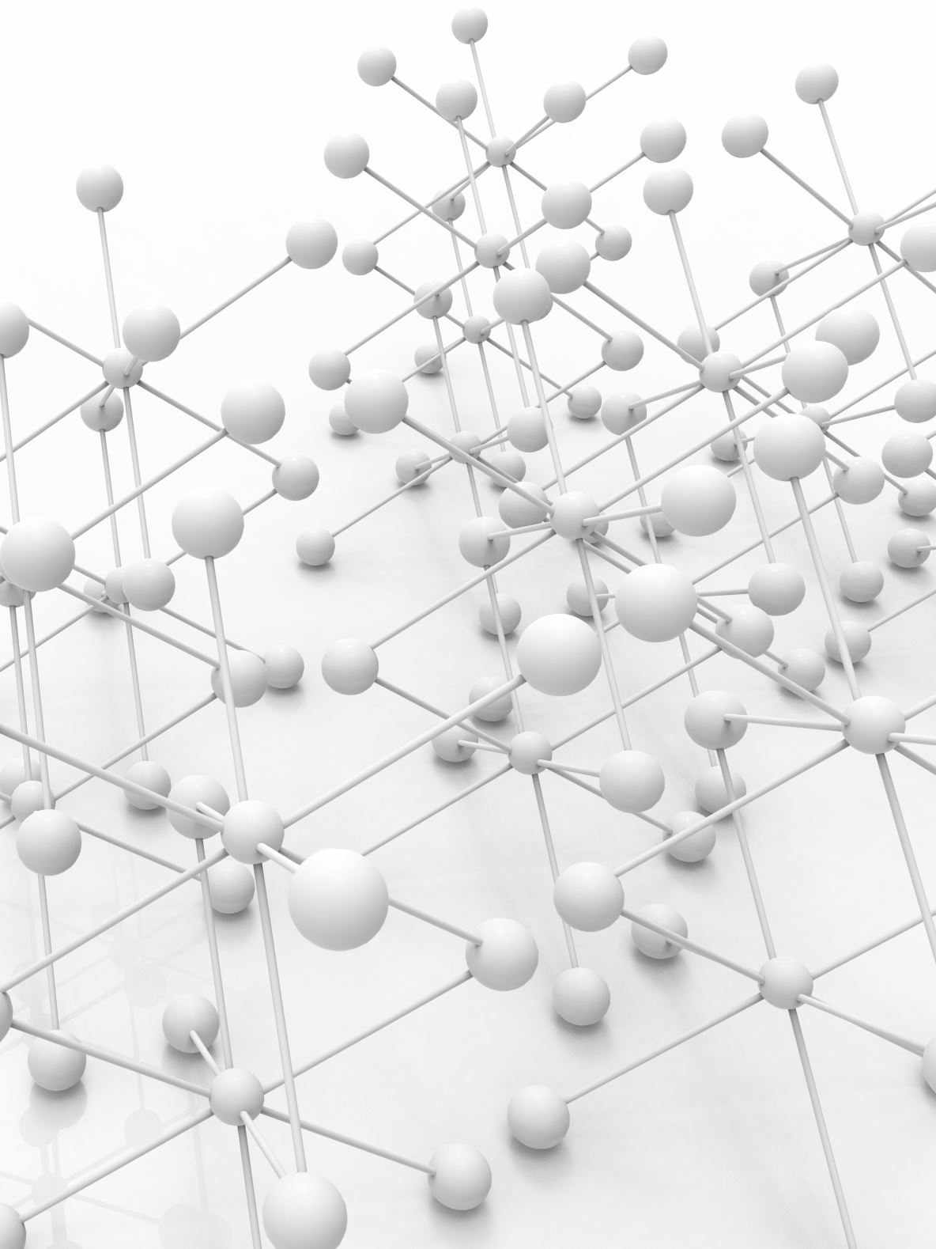
SSSP Computation - Basics
SSSP computes shortest paths from source to all vertices
Output is a spanning tree (SSSP tree)
Classical algorithms:
Dijkstra's algorithm: O(|E| + |V|log|V|)
Bellman-Ford algorithm
Sequential update algorithms exist
Limited scalability for large networks

Slide 6

Key Contributions
1. Platform-independent parallel framework for SSSP updates
2. Rooted tree-based data structure for efficient updates
3. Novel techniques for synchronization and load balancing
4. Implementations for both:
Shared-memory (OpenMP)
GPU (CUDA)
5. Handles changes in batches for better performance

Slide 7
Technical Details: Algorithm Overview
Two-step approach:
1. Identify subgraphs affected by changes
2. Update affected subgraphs to create new SSSP tree
Data structures:
SSSP tree as adjacency list
Per vertex: Parent, Distance, Affected flags

Slide 8
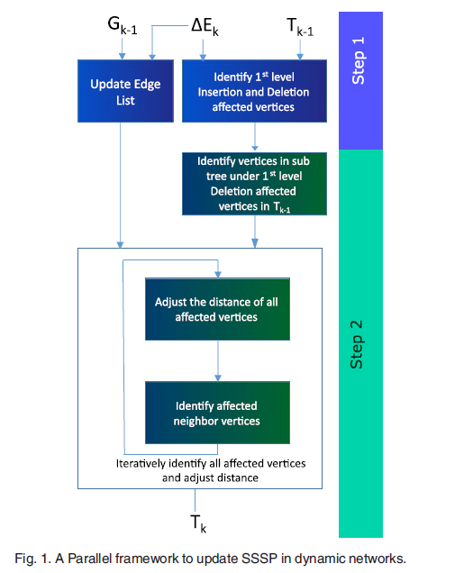
SSSP Updation in Dynamic Networks

Slide 9
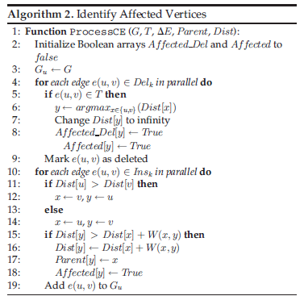
Technical Details: Step 1 - Identify Affected Vertices

Slide 10
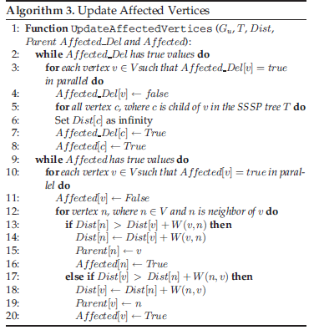
Technical Details: Step 2 - Update Affected Subgraphs

Slide 11
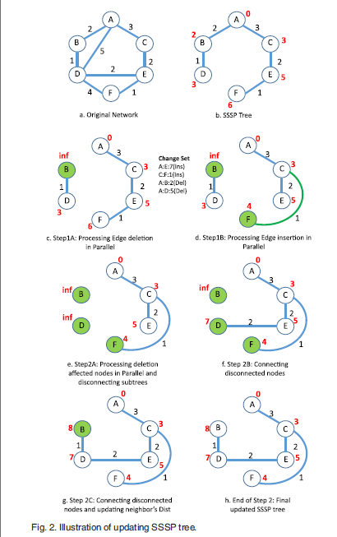
Updating SSP Trees

Slide 12
Technical Details: Challenges Addressed
1. Load Balancing
• Subtrees have different sizes
• Solution: Dynamic scheduling
2. Synchronization
• Multiple processors updating same vertices
• Solution: Iterative updates instead of locks
3. Cycle Prevention
• Parallel edge insertions can create cycles
• Solution: Process deletion-affected vertices first

Slide 13
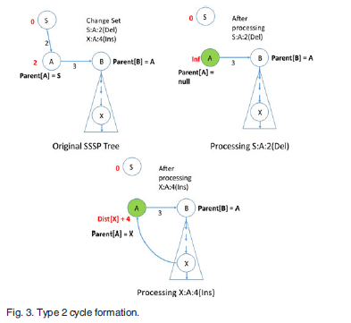

Slide 14
Technical Details: Shared-Memory Implementation
• OpenMP-based implementation
• Parallelization with #pragma omp parallel for
• Dynamic scheduling for load balancing
• Asynchronous updates to reduce synchronization overhead
• Batch processing for large change sets
C++ Code:
#pragma omp parallel schedule(dynamic)
for (v ? V) {
if (Affected[v] == True) {
// Process affected vertex and its neighbors
// Update distances iteratively
}
}

Slide 15
Technical Details: GPU Implementation
• CUDA-based implementation
• Novel Vertex-Marking Functional Block (VMFB) approach
• Three steps in VMFB:
1. Vertex Marking: Parallel operations on vertices
2. Synchronization: Global barrier
3. Filter: Collect marked vertices
VMFB(Array_operand, Fx, Flags, P):
// Allocate threads to each element of Array_operand
// Parallel execution of Fx function
// Filter marked vertices based on predicate P

Slide 16
Experimental Results: Setup
• Hardware:
• GPU: NVIDIA Tesla V100 with 32GB memory
• CPU: Intel Xeon Gold 6148 with 384GB memory
• Datasets:
• Real-world networks: BHJ, soc-Orkut, LiveJournal
• Synthetic networks: Graph500, RMAT
• Sizes: 1.8M-16.7M vertices, 106M-258M edges
• Experiment parameters:
• 50M and 100M edge changes
• Various ratios of insertions/deletions

Slide 17
Experimental Results: GPU Implementation
• GPU implementation outperforms recomputation (Gunrock)
• Up to 8.5x speedup for 50M changes
• Up to 5.6x speedup for 100M changes
• Best performance when insertion percentage is high (>75%)
• Recomputation becomes more efficient when:
• Deletion percentage exceeds 75%
• Changes affect >50% of the network

Slide 18
Experimental Results: Shared-Memory Implementation
• Shared-memory implementation outperforms recomputation (Galois)
• Up to 5x speedup
• Good scalability with increasing thread counts
• Asynchronous updates improve performance
• Batch processing shows performance gains on higher thread counts
• Performance decreases when >80% of nodes are affected

Slide 19
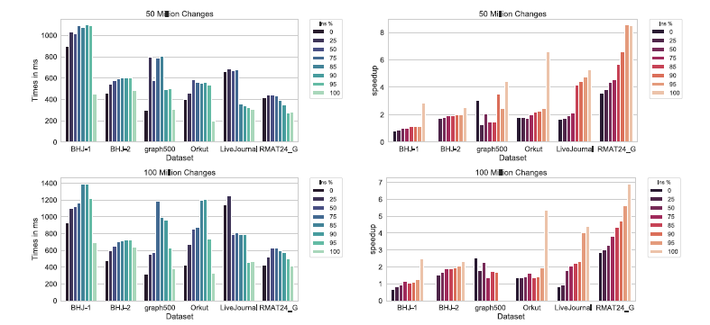
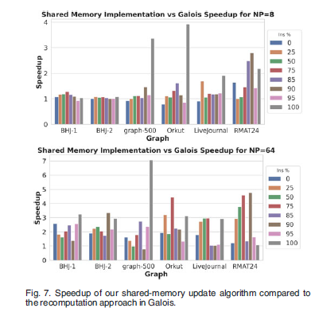
Results Summary
• The parallel update algorithm is effective when:
• Changes affect <80% of the network
• Insertion percentage is high
• Performance factors:
• Network structure
• Location of changes
• Ratio of insertions to deletions
• When to use recomputation:
• High deletion percentage (>75%)
• Changes affect majority of network

Slide 20
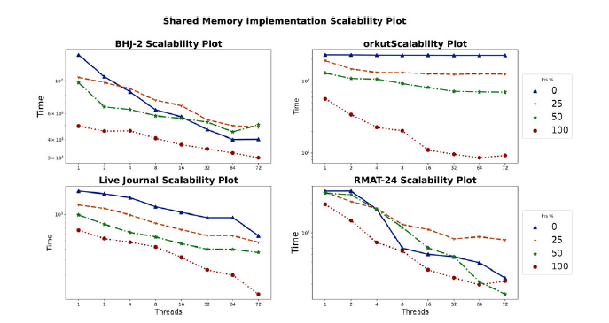
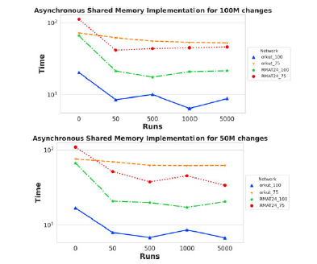
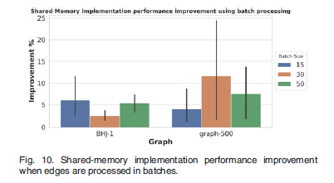
More Results

Slide 21
Parallelization Strategy Proposal: Overview
• Combine three technologies:
1. MPI for inter-node communication
2. OpenMP for intra-node parallelism
3. METIS for graph partitioning
• Leverage the paper's two-step approach
• Add distributed processing capabilities

Slide 22
Parallelization Strategy: METIS Graph Partitioning
• Use METIS to partition initial graph into P subgraphs
• Balance vertex count while minimizing edge cuts
• Partition strategy:
• Vertex weights based on degree or computational load
• Focus on minimizing SSSP tree edge cuts
• Consider dynamic repartitioning for large batches

Slide 23
Parallelization Strategy: MPI Implementation
• Each MPI process manages one partition
• Ghost vertices at partition boundaries
• Message-passing protocol:
• Local computation phase
• Communication phase for boundary vertices
• Repeat until global convergence
• Distribute changed edges to relevant partitions
• Aggregate results through MPI reduction operations
// MPI pseudo-code
MPI_Init(&argc, &argv);
MPI_Comm_rank(MPI_COMM_WORLD, &rank);
MPI_Comm_size(MPI_COMM_WORLD, &size);
// Distribute graph with METIS
local_graph = distribute_graph(global_graph, rank, size);
do {
// Local computation
local_changes = update_SSSP_local(local_graph, local_changes);
// Exchange boundary information
exchange_boundary_info(local_changes);
// Check global convergence
MPI_Allreduce(&local_converged, &global_converged, 1,
MPI_INT, MPI_MIN, MPI_COMM_WORLD);
} while (!global_converged);

Slide 24
Parallelization Strategy: OpenMP Implementation
• Thread pool management with #pragma omp parallel
• Dynamic scheduling for load balancing
• Thread-local storage for intermediate results
• Asynchronous updates with configurable levels
• Batch processing implementation
• Minimal use of atomic operations
// OpenMP pseudo-code for Step 2
#pragma omp parallel
{
while (global_changes) {
#pragma omp for schedule(dynamic)
for (int v = 0; v < num_vertices; v++) {
if (Affected[v]) {
// Process affected vertex and its neighbors
// Update distances iteratively
}
}
#pragma omp barrier
#pragma omp single
{
global_changes = check_for_changes();
}
}
}

Slide 25
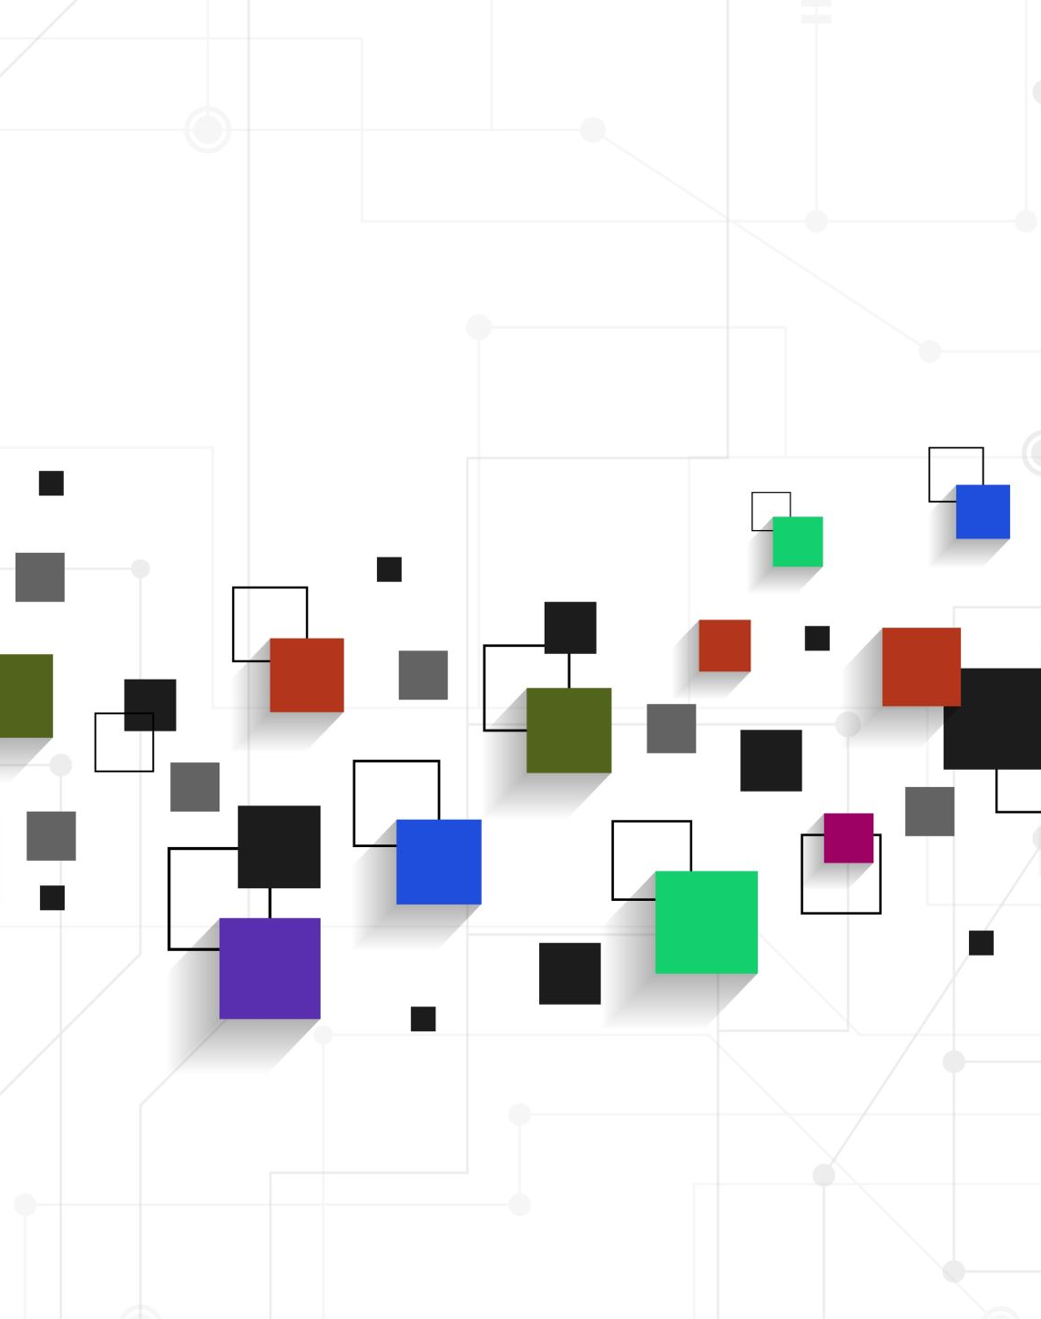
Parallelization Strategy: Integration
• Hierarchical parallelism:
• MPI for distributed memory across nodes
• OpenMP for shared memory within nodes
• Data partitioning optimized with METIS
• Communication optimization:
• Minimize messages at partition boundaries
• Batch updates for efficiency
• Scale out to multiple nodes while maintaining algorithm correctness

Slide 26

Implementation Challenges & Solutions
• Cross-Partition Updates:
- Solution: Ghost vertices + communication protocol
• Load Balancing:
- Solution: Dynamic assignment of partitions
• Synchronization:
- Solution: Adapt iterative convergence approach
• Memory Management:
- Solution: Efficient data structures for distributed memory

Slide 27

Conclusion & Next Steps
Paper presents an efficient parallel framework for SSSP updates in dynamic networks
Significant performance improvement over re-computation approaches
Our implementation will:
Extend to distributed memory with MPI
Optimize partitioning with METIS
Maintain correctness and performance benefits
Key challenges:
Boundary vertex communication
Load balancing across partitions
Efficient synchronization

Slide 28

Thank You
Any Questions?

